Slide 1



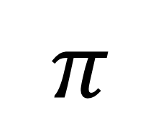

My Circle Interactive Notebook
$$π$$
$$d$$
$$r$$
$$C$$
Name
Class
Teacher
Term 1 Semester 1
$$d$$
1

Slide 2
Contents
Glossary or Formula Page
Page
Date
Description
2
3

Slide 3
Tasks
24
7
30
Essential Question
Questions
Notes
Summary
6
7

Slide 4


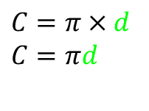
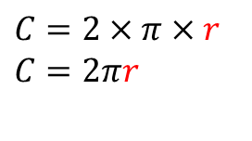

24
7
30
Date
Circumference of Circles
EQ – How do I use the radius or diameter to find the circumference?
What the circumference?
What is pi?
Perimeter of a circle
$$π=3.14159264…….$$
How do I find the circumference?
$$r$$
$$C=2×π×r$$
$$C=2πr$$
$$C=π×d$$
$$C=πd$$
$$d$$

Slide 5


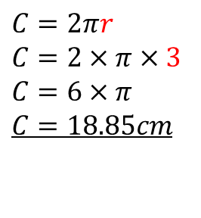
24
7
30
Date
Circumference of Circles
EQ – How do I use the radius or diameter to find the circumference?
What the circumference?
What is pi?
Perimeter of a circle
$$π=3.14159264…….$$
How do I find the circumference?
$$r$$
$$C=2×π×r$$
$$C=2πr$$
$$C=π×d$$
$$C=πd$$
$$d$$
Examples
$$3cm$$
$$C=2πr$$
$$C=2×π×3$$
$$C=6×π$$
$$C=18.85cm$$
$$d$$

Slide 6

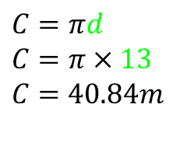
24
7
30
Date
Circumference of Circles
EQ – How do I use the radius or diameter to find the circumference?
What the circumference?
What is pi?
Perimeter of a circle
$$π=3.14159264…….$$
How do I find the circumference?
$$r$$
$$C=2×π×r$$
$$C=2πr$$
$$C=π×d$$
$$C=πd$$
$$d$$
$$3cm$$
$$C=2πr$$
$$C=2×π×3$$
$$C=6×π$$
$$C=18.85cm$$
$$C=πd$$
$$C=π×13$$
$C=$ $40.84m$
$$13m$$

Slide 7
Dwyer page 124
Draw the diagram and show the working out

Slide 8
Notes Review
24, 7 ,30
Date
Title
Essential question
Notes complete
Notes complete with colour and diagrams
Questions completed
Contents page filed in
Formula page filled in

Slide 9
Homework
Review your notes and write a summary answering the essential question.

